Slide 1

Formflow
Your personal AI train coach
NYC Build With AI Hackathon at NYU Tandon School of Engineering

Slide 2

IF you
Don’t know
How to start?
FormFlow

Slide 3

IF you
Don’t know If you’re Doing it right !
FormFlow

Slide 4

IF you
Forget your Sets and Reps !!
FormFlow

Slide 5
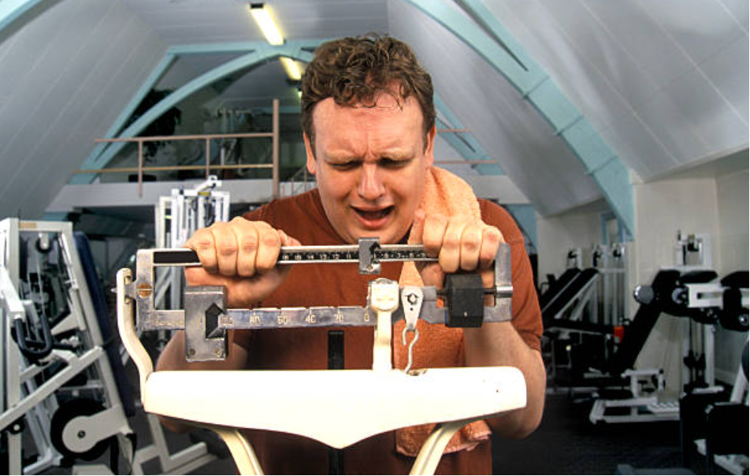
IF you’re not sure
If today’s workout is too intense
FormFlow

Slide 6
Formflow
AI agent
can totally Help you

Slide 7


Slide 8
Think
Track
Improve
AI Workout Planner
Real-time record your sets and reps
Live Audio Workout Coaching

Slide 9
Thank You
Group Members
Alaia Zhan - yz12709@nyu.edu
Yang Zhang - yz12043@nyu.edu
Yifan Wang - yw8986@nyu.edu

